Slide 1


21 DAYS OF
MACHINE LEARNING
16/21
---Code Warriors---

Slide 2

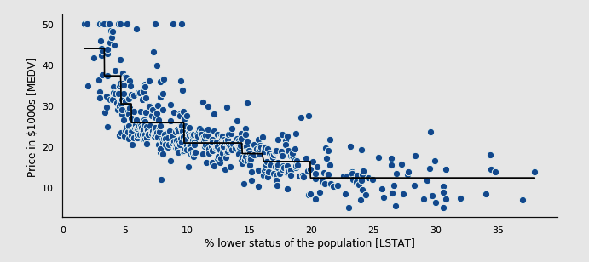
What is Decision Tree Classification
Decision tree is a flowchart like tree structure, where each internal node denotes a test on an attribute, each branch represents an outcome of the test, and each leaf node( terminal node ) holds a class label.
---Code Warriors---

Slide 3
Flowchart
Outlook
Sunny
Overcast
Rain
Humidity
Yes
Wind
High
Normal
Strong
Weak
No
Yes
No
Yes
---Code Warriors---

Slide 4
Applications of Decision trees
Biomedical Engineering
Medicine
Astronomy
Financial analysis
Manufacturing and Production
---Code Warriors---

Slide 5
Decision Tree Classification Model
1
from sklearn.tree import DecisionTreeClassifier
2
classifier = DecisionTreeClassifier(criterion = 'entropy', random_state = 0)
3
classifier.fit(X_train, y_train)
4
y_pred = classifier.predict(X_test)
---Code Warriors---

